Slide 1
OUTLINE
ABSTRACT
INTRODUCTION
LITERATURE STUDY
ARCHITECTURE DIAGRAM
MODULES
ADVANTAGES
SYSTEM REQUIREMENTS
REFERENCES

Slide 2
ABSTRACT
Motion detection is an important component of security systems, as it allows for the identification of potential threats in real-time. In recent years, computer vision techniques have become increasingly popular for motion detection, particularly using the OpenCV library.
The motion detection alarm system using OpenCV detects motion in real-time through a camera and the OpenCV library, using tools like background subtraction.
This system will detect motion in real-time using a camera and OpenCV library tools, triggering an alarm to alert users when motion is detected, making it useful for security, industrial, and traffic monitoring applications.

Slide 3
INTRODUCTION
A motion detection alarm system using OpenCV is a real-time monitoring system that uses a camera and OpenCV library tools to detect motion. The system works by capturing a video feed of the area being monitored and processing it in real-time using the OpenCV library to detect any changes in the scene. When motion is detected, an alarm is triggered to alert the user of the potential threat. This system offers benefits such as affordability, accessibility, and ease of use. With the increasing availability of affordable cameras and the widespread use of computer vision techniques, motion detection alarm systems using OpenCV are becoming more accessible and popular. Overall, it offers a reliable, effective, and user-friendly solution for real-time monitoring and detection of potential threats.

Slide 4
LITERATURE STUDY
Title | Advantages | Disadvantages
"Motion Detection Algorithm based on OpenCV" by Zhang Xuecheng and Zou Jianping. Journal of Physics: Conference Series, vol. 1529, no. 1, 2020. | Evaluates the performance of the system on a dataset of vehicles and reports high detection and classification accuracy. | Incomplete or Inaccurate Documentation Insufficient Evaluation and Benchmarking
"Motion Detection using OpenCV and Deep Learning" by R. Priyadarshini and P. Ramesh. International Journal of Computer Science and Mobile Computing, vol. 8, no. 10, 2019. | Provides an overview of various motion detection models, including region-based and single-shot detectors. Discusses the challenges in motion detection, such as occlusion, scale variation,etc. | Limited Scope or Generalizability Outdated Information
"Real-Time Motion Detection Using OpenCV" by Fahim Rahman, Md. Munirul Islam, and Shyamal Chandra Das. International Journal of Computer Applications, vol. 58, no. 4, 2012. [4]. | Provides a comprehensive review of deep learning-based motion detection, including Faster R-CNN, YOLO | Bias or limitations in methodology Lack of comparative analysis

Slide 5
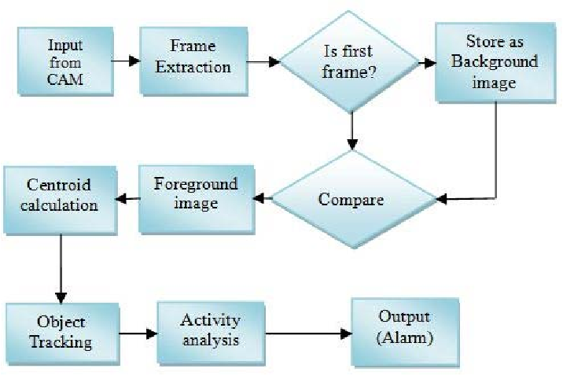
ARCHITECTURE DIAGRAM

Slide 6
MODULES
Main.py – This is the main processing module of the system which gets the video stream as the input and converts it into frames and checks the variation in the threshold of the two frames and triggers the alarm.
Keys.py – This is the secondary module which comprises of the API keys that are made use to generate the alert SMS and the emergency numbers of the users to which the SMS is sent.

Slide 7
ADVANTAGES
Real-time monitoring: The system detects motion in real-time, allowing for immediate action to be taken if a threat is identified.
Cost-effective: The system is affordable, as it uses readily available components, such as cameras and the OpenCV library.
Easy to use: The system is user-friendly, as it can be set up and configured easily, with no specialized knowledge required.
Versatile: The system can be used in a variety of applications, including home security, industrial monitoring, and traffic surveillance, making it a versatile solution for a range of monitoring needs.

Slide 8
HARDWARE REQUIREMENTS
SYSTEM REQUIREMENTS
Processor : Intel i3 5th Gen or Higher
OS : Windows 10 or higher
RAM : 4 GB
SOFTWARE REQUIREMENTS
Software : Visual Studio Code , Anaconda
Version : 3.8.0 or above
Language : Python , SQL

Slide 9
REFERENCE
There are several papers available in IEEE that can be used as references for OpenCV based motion detection projects.
"Motion Detection Algorithm based on OpenCV" by Zhang Xuecheng and Zou Jianping. Journal of Physics: Conference Series, vol. 1529, no. 1, 2020.[1].
"Motion Detection using OpenCV and Deep Learning" by R. Priyadarshini and P. Ramesh. International Journal of Computer Science and Mobile Computing, vol. 8, no. 10, 2019. [2].
"Motion Detection using OpenCV and Optical Flow Analysis" by R. G. Gaikwad and P. R. Deshmukh. International Journal of Advanced Research in Computer Science and Software Engineering, vol. 3, no. 9, 2013. [3]
"Real-Time Motion Detection Using OpenCV" by Fahim Rahman, Md. Munirul Islam, and Shyamal Chandra Das. International Journal of Computer Applications, vol. 58, no. 4, 2012. [4].

